Slide 1
Industrial DevOps
“What are the barriers?”
Robin Yeman
Catalyst Campus
Robin.Yeman@catalystcampus.org
Dr. Suzette S. Johnson
Northrop Grumman Corporation
Suzette.Johnson@ngc.com
© 2021 Northrop Grumman Systems Corporation
Notes:
Welcome! Thank you for the opportunity to be here and for joining us in this session as we share with you: Industrial DevOps – What are the barriers?
In this presentation, Robin and I will continue the Industrial DevOps journey. We will briefly revisit the principles of Industrial DevOps and then discuss barriers to an IDO transformation with some recommendations based on research and our own experiences and we believe that you have likely experienced some similar situations.

Slide 2
Abstract
In 2009 Patrick Debois coined the term DevOps at a Velocity event in Belgium. 12 years later there have been countless books to describe this cooperation between development and operations to deliver capability rapidly to the user. We further have extended that term into Industrial DevOps to account for complex system of systems which include hardware, firmware, and software. Many of the practices such as small batch sizes, limit work in progress, and organizing around value are not new. The benefits of these practices in quality, schedule, cost, transparency, value are undisputed facts that have been shown repeatedly in periodicals such as the DORA report.
The question is if the ideas are not new, and the benefits are proven why is it so difficult for organizations to move to DevOps and almost impossible to move to Industrial DevOps. Robin Yeman, Senior Lockheed Martin Fellow and Suzette Johnson Senior Northrop Grumman Fellow will walk through the common barriers to adoption they see in these two large scale companies as well as invite the audience to participate in potential root causes of these barriers. The barriers we will discuss are Organizational Structure, Psychological Safety, Access to Common Language, Understanding the Value Stream, Lack of Trust, Access to patterns to break down systems, and exclusive over inclusive behaviors. In this session you will not only hear stories of programs who are experiencing these barriers you will have the opportunity to collaborate on solutions.

Slide 3

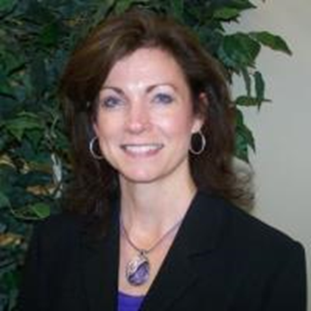
Robin Yeman
Chief Technical Officer Catalyst Campus
Advisory Board
Project&Team
Suzette S. Johnson
NG Senior Fellow
Enterprise Lean-Agile Strategy Northrop Grumman

Slide 4
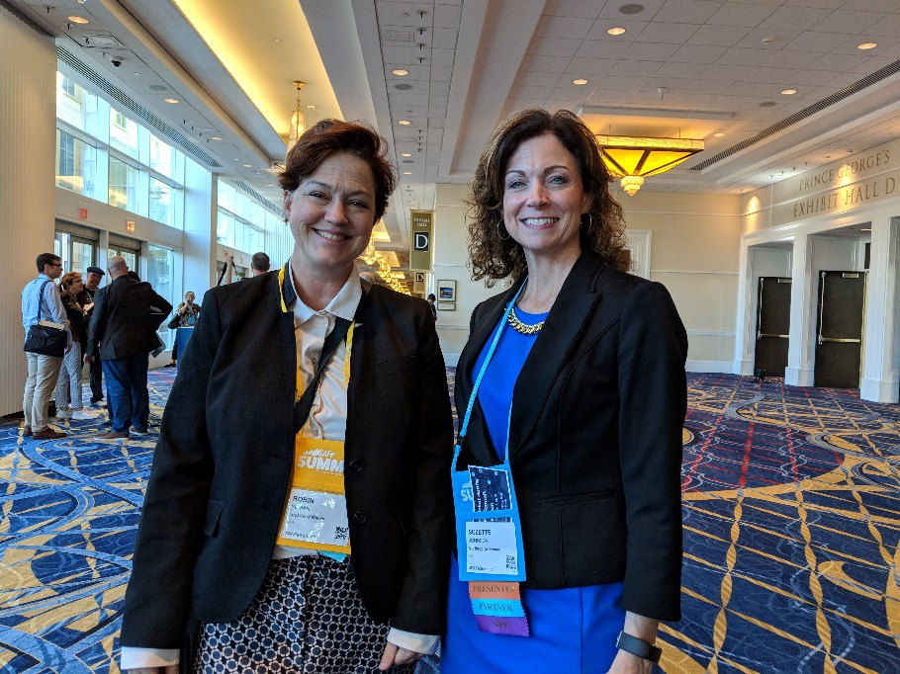
Introductions
Robin Yeman
Suzette Johnson
A continuous learning journey

Slide 5
Industrial DevSecOps Principles
Visualize and organize around the value stream
Multiple Horizons of Planning
Base decisions on objective evidence of system state and performance
Architect for Scale, Modularity, and Serviceability
Iterate / Reduce batch size / Get fast feedback
Cadence and Synchronization
Continuish Integration
Test Driven Development
“DevOps is a mixture of people, process, and technologies that provides a delivery pipeline enabling organizations to move both responsively and efficiently from concept to business outcome.” - Robin Yeman
Notes:
IDO is designed for large cyber physical solutions
There are 8 principles…
As we discuss barriers to transformation we stay centered on principle 1 which is to ensure the organization is organized and centered on the delivery of value.

Slide 6
Alset’s Current Situation
Alset Transport is fictitious company who produces vehicles to support assisted and autonomous driving in both the commercial and consumer markets.
Notes:
Alset Transport needs to manage challenges including multiple competitors, rapidly changing technology, regulatory compliance, and safety concerns.

Slide 7
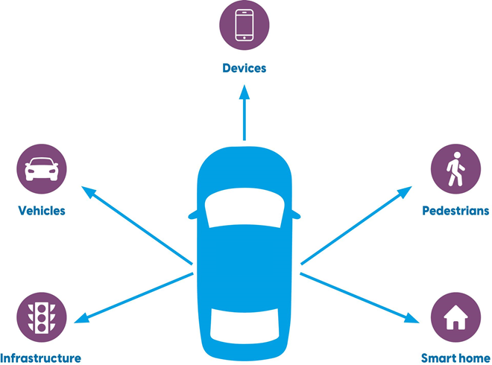
New Federal DevOps Program Awarded to Alset
Autonomous Transportation Communication System (ATCS)
$5B in federal funding
Why
Decisions Made
We must get started quickly, we can’t reorganize the entire company, but we will use IPTs for cross functional teams
Use Alset’s existing functional org structure
We need to identify how much work we have by function to staff correctly
Engineers to allocate all requirements to functions
We must understand the whole system and show progress, so we do not lose funding
Use sprints to build architectural artifacts
Develop a detailed Integrated Master Schedule
The customer wants to know when we will be done, and we must bring together products from multiple suppliers
Hold a hiring event to staff 500 – 1000 positions
ATCS
We must go fast to keep funding, domain knowledge is not that important
Create Detailed Statements of work for suppliers
We must hold feet to fire and manage scope
Start all features in program at once
We hired a lot of staff and need to keep everyone busy
Notes:
Companies and Programs want the benefits of Agile and DevOps
They understand the need to change, but make decisions
Counter to these beliefs with new or transforming programs, often for good reason.

Slide 8
Alset’s Industrial DevSecOps Challenge
What are barriers to Alset’s transformation?
What are recommended tactics?
Notes:
Alset experienced some challenges along their Industrial DevOps journey. As the experienced these challenges the team also addressed these barriers through a variety of practices. We have captured these experiences in the form of recommendations.

Slide 9

Six Barriers
Challenges with the existing organizational structure
Lack of common language in the new way of working
Not understanding the Value Stream
Access to patterns to break down the system
Valuing exclusivity over inclusivity
Lack of Psychological Safety
Notes:
Image – Bing – public domain
There are many barriers to change an organization faces. Here are six barriers that continue to emerge in large organizations. We recognize there are many barriers that an organization may face that we have not listed.
Interesting read: Infographic: The Iceberg That Sinks Organizational Culture Change (visualcapitalist.com)

Slide 10

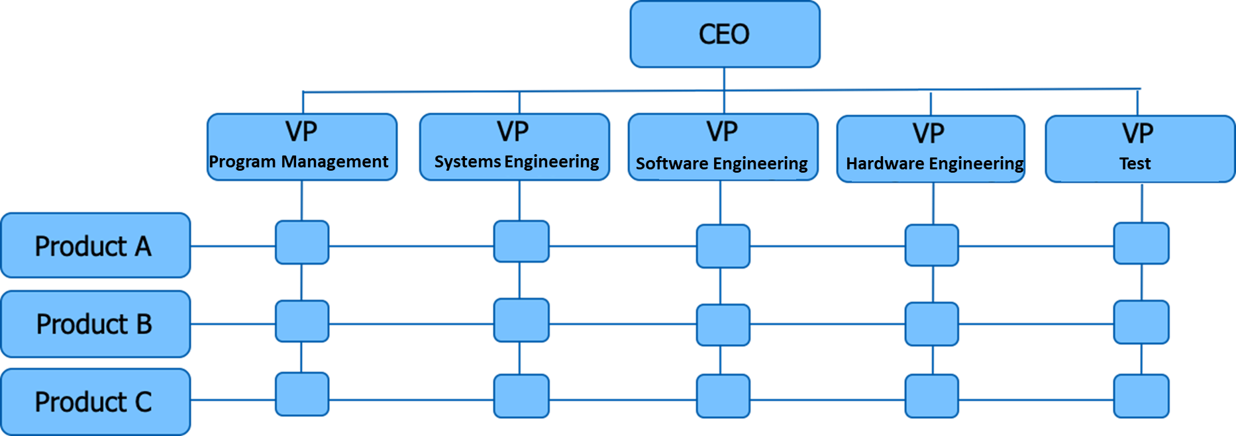
Challenges with the existing organizational structure
Barrier
DevOps Coach
Executive
Conway's Law
Incentive mismatch
Handoffs cause delays
Reduce dependencies
Specialization creates efficiency
Clear roles and responsibilities
Existing role descriptions
Schools educate by function
Recommendation to the business
Decide if you want to optimize for product delivery or individual specialization and efficiency
Consider a dual operating structure to build synergies within the organization
Conduct an impact analysis as part of the decision-making process
Involve technical people in organization design of the team structure
Notes:
Team Topology p.24
Organizational Structure (reference Team Topologies/Chap 1 on Comm Structures): which how the organization aligns its people and teams to provide value. The structure is important to ensure we are organizing around value delivery and to enable decision making at the right levels along with improving the flow of information and collaboration. For example, are teams aligned around features or components and as the build the solution how often do their changes have a rippling effect across other teams. This rippling impact is often caused by the system structure or architecture or how the organization has defined the team structure. This is an important element that requires attention to ensure teams are able to build new capabilities and functionality with minimal impact to the other teams.

Slide 11
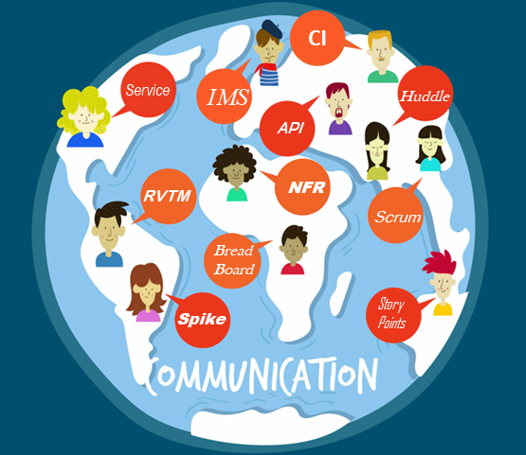
Lack of common language in the new way of working
Barrier
DevOps Coach
Executive
Cross-functional teams reduce handoffs
Working together drives innovation
Cross-functional teams don’t understand each other
Language barrier reduces trust
Recommendation to the business:
Agree upon a common language
Identify terminology and lexicon
Map them together and make it visible and accessible
Create a Rosetta Stone when you need to align process to tools

Slide 12
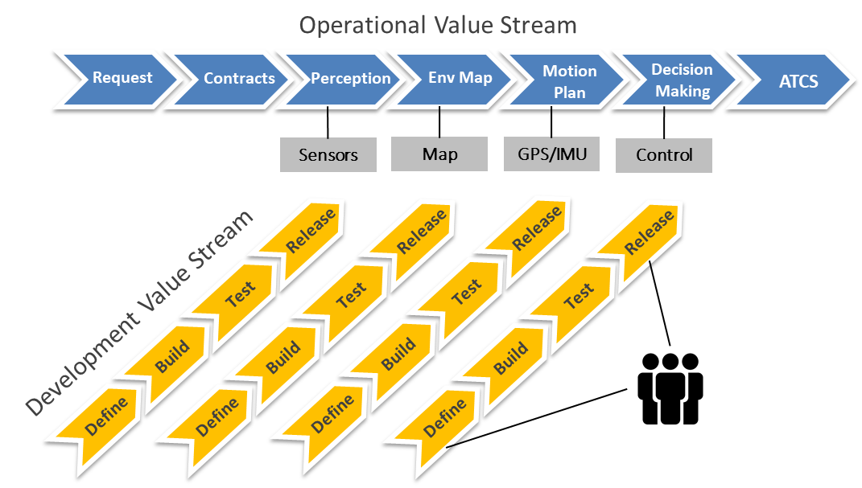
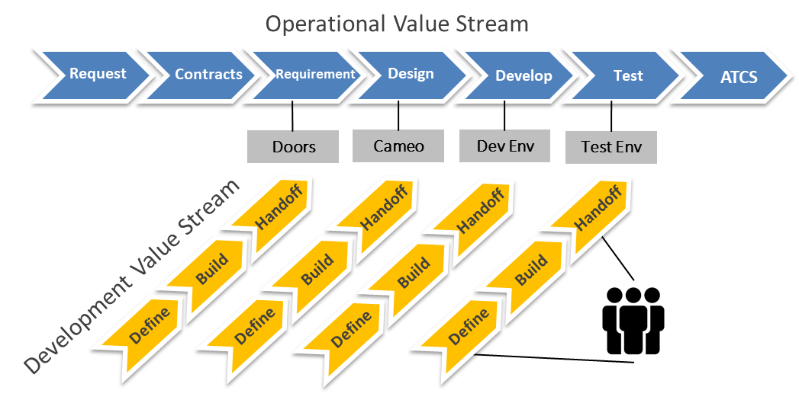
Not understanding the Value Stream
Barrier
DevOps Coach
Executive
Organize teams around value stream
Make improvement metrics visible
Organize Teams around value stream
Use metrics to make decisions
Recommendation to the business
Hold training and workshops on value stream mapping, this is often misunderstood
Identify bottlenecks in your value stream and create improvement items (Current state, Improvement, New State)
Use metrics to understand the impacts of change
Use a modeling tool make the value stream visible
Revisit regularly
How well do you understand your portfolio and value streams?
Notes:
Alset, like so many organizations, struggled to understand their value stream….the end-2-end flow from customer need to value delivery. This isn’t really surprising as defining the value stream in solutions that include both hardware and software is a significant undertaking.
Why d we care?
Value streams allow you to measure and visualize, in real time, the flow metrics and the progress that is being made.
Discover the bottlenecks in the system
It takes time to really understand and capture your portfolio’s value stream.
And that is the first recommendation. Due to the growing complexities of the solutions, organizations should start their transformation by understanding their value stream and where to start their transformation journey based on the priorities of the organization.
So, some ways to address these challenges:
Hold training and workshops on value stream mapping, this is often misunderstood
Identify bottlenecks in your value stream and create improvement items (Current state, Improvement, New State)
Use metrics to understand the impacts of change
Use a modeling tool make the value stream visible
Revisit regularly
Team Topologies p.86 who also references Accelerate (continuous learning and technical specialists (similar to SAFe’s shared services concept)
We know Conway’s Law that “organizations which design systems…are constrained to produce design which are copies of the communication structures of these organizations.”
It’s similar to having a common API, defined interface, between the teams like we have when building system components. Define the team interfaces be cognizant of the communication flows across the teams.

Slide 13
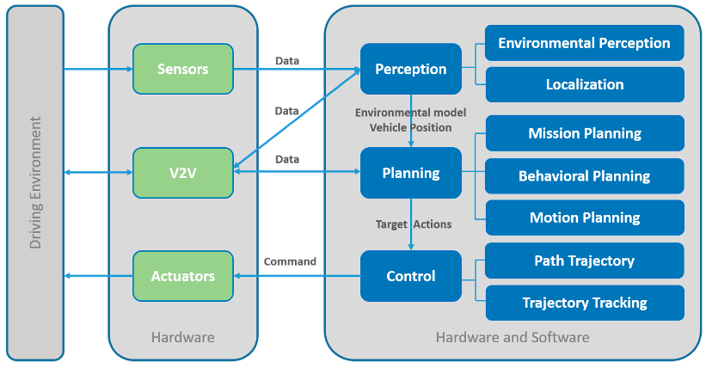
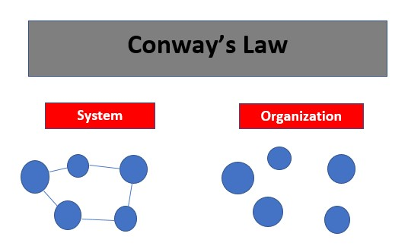
Access to patterns to design system
Barrier
“Any organization that designs a system will inevitably produce a design whose structure is a copy of the organizations communication structure”
DevOps Coach
Executive
Hardware
Systems
PMO
Test
Software
Design systems around products and services
If we have good documentation and clear roles and responsibilities functional based teams should work fine
Recommendations to the business
Decompose your system into outcome-based products not by functional roles
Shift to product teams versus project teams
Architect to reduce handoffs
Create small, cross functional, persistent teams that share a common set of practices and rules of engagement
Notes:
So, some ways to address these challenges:
Create small, cross functional, persistent teams that share a common set of practices and rules of engagement
Support self-managing teams and explicitly agree on interaction modes with other teams to include the expectations on behaviors.
Create not only a system architecture but an organization architecture designed to reduce handoffs while improving the interfaces, that is, the collaboration points, between the multiple development teams while using a common, defined set of practices.
technical competence – ensure the teams have the technical competency, that is skills, to complete the required actions and work in the new environment; Leaders ensure that employees have the training, resources, and opportunities to gain these new skills such as training on new tools, used of digital twins, or automation environments. This means organizations will need to invest more in skill and talent development.

Slide 14
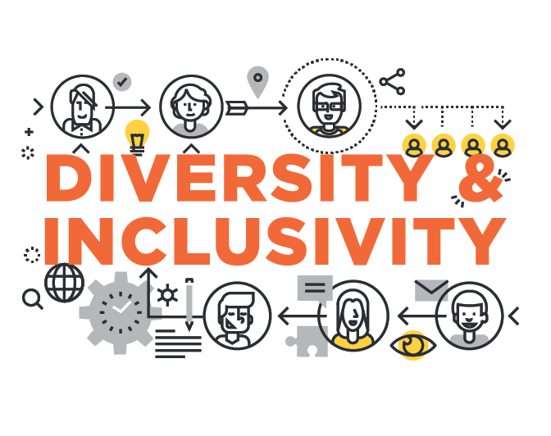

Valuing exclusivity over inclusivity
Barrier
DevOps Coach
Executive
Diverse culture, skills, and experience produce better products
Inclusive environments have happier employees
I have earned my position
I have more knowledge
I’m special
Recommendation to the business
Apply a growth mindset
Use a model for Decentralized Decision making
Build safe environments where ideas are shared openly
Ask questions and practice active listening
Access to tools where teams can brainstorm and exchange ideas easily
“Diversity produces greater proportion of revenue from innovation than companies with below average diversity.” Forbes, 2020
Notes:
How diversity can create an innovative culture: How Diversity Can Drive Innovation (hbr.org)
Diversity Confirmed To Boost Innovation And Financial Results (forbes.com)
Companies with above-average diversity produced a greater proportion of revenue from innovation (45% of total) than from companies with below average diversity (26%). This 19% innovation-related advantage translated into overall better ﬁnancial performance. Jan 15, 2020
The Role of Diversity in Innovation - Tangocode

Slide 15

Lack of Psychological Safety
Barrier
DevOps Coach
Executive
Transparency is critical
Failure needs to be an option
We need to keep funding
People want to see success
Success allows you to move up
Recommendation to the business
Lead by example. Be present.
Assess your culture
Build a Generative Culture
Intent based leadership
Consider re-evaluating performance appraisals from top down to bottom up and build leader competencies
“Psychological safety is a belief that one will not be punished or humiliated for speaking up with ideas, questions, concerns, or mistakes.” Amy Edmondson, Harvard Business School
Notes:
Image - Bing
Create a culture of psychological safety (Amy Edmondson), Generative Culture (Ron Westrum)
DevOps culture: Westrum organizational culture | Google Cloud

Slide 16
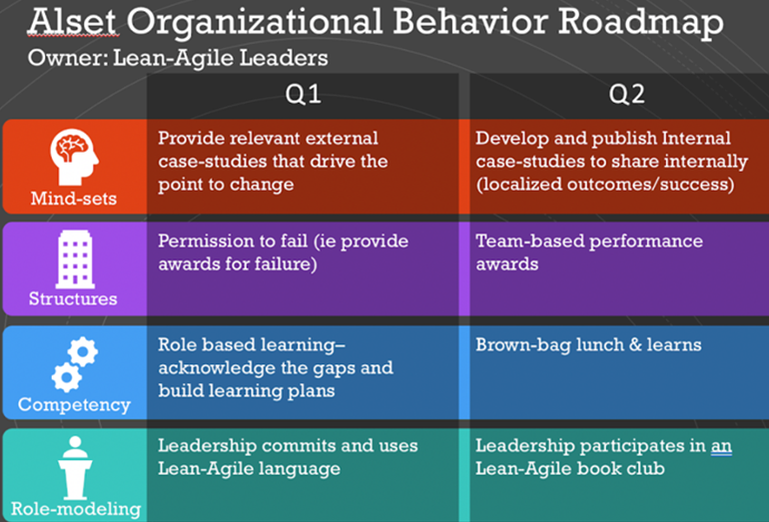
Create an intentional culture
As Alset transitioned to apply Industrial DevOps across the organization, it came to understand that many of the barriers to implementation stemmed from Alset’s organizational culture.
Mind-set Validation
Org Surrounding Support Structure
Technical Competency
Active Role-modeling
Notes:
Image - we created this image
Suzette:
Addressing the barriers to Industrial DevOps transformation needs to be intentional. The guiding coalition or leadership team creates a roadmap that addresses the barriers through the implementation of success patterns, principles and mindset for this new way of working. This creates actionable steps that the organization can take to drive improvements towards achieving their desired business outcomes and desired results.
This example is organized around 4 areas: Mindset validation, Support structures of the organization, technical competency, and role-modeling.
As the improvements are implemented it is important to communicate to the rest of the organization what success looks like.
Success build more success.

Slide 17
Questions?

